Slide 1
Women’s Political Representation in African Rebel Parties
Replication Study – Sophie McDonnell

Slide 2
Paper Overview:
Research Question: Do rebel parties run and elect a higher proportion of women candidates than non-rebel parties?
Author: Elizabeth Brannon
Source: Journal of Politics
Brannon, Elizabeth, 2022, "Replication Data for: Women’s Political Representation in African Rebel Parties", https://doi.org/10.7910/DVN/CHLLZ4, Harvard Dataverse, V1, UNF:6:x/tcw47f0zMZ08IpWxhgyA== [fileUNF]

Slide 3
Paper Overview:
Abstract:
“Across Africa, women’s political representation is nearly twice as high in post-conflict states than it is in non-conflict afflicted states (Hughes and Tripp 2015). Scholars have attributed these increases to changing gender norms, international pressure, and local women’s movements. However, these factors do not explain variance in women’s representation across political parties. This paper seeks to understand how the conflict legacies of political parties influence these trends by analysing pa terns of women’s political representation in rebel groups that transition into political parties.”
“Findings suggest that rebel parties run and elect significantly more women than other political parties. These results are consistent among a number of contexts, including varying conflict outcomes. Further, findings demonstrate that in instances of ongoing violence, women’s political representation generally falters, suggesting that these political strategies are only effective during peace time. These findings are relevant to understanding women’s post-conflict political representation, as well as the role of women in former rebel parties.”

Slide 4
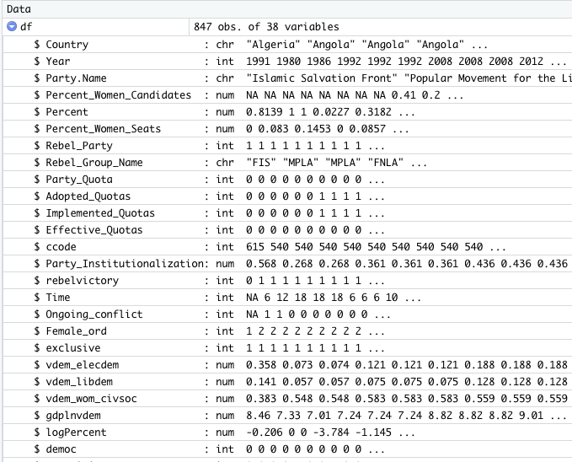
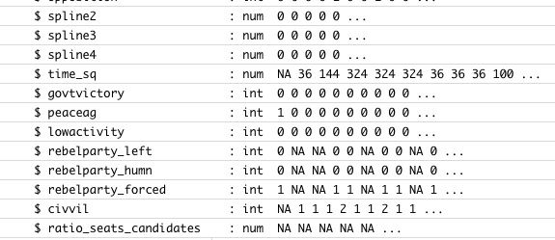
Data:

Slide 5
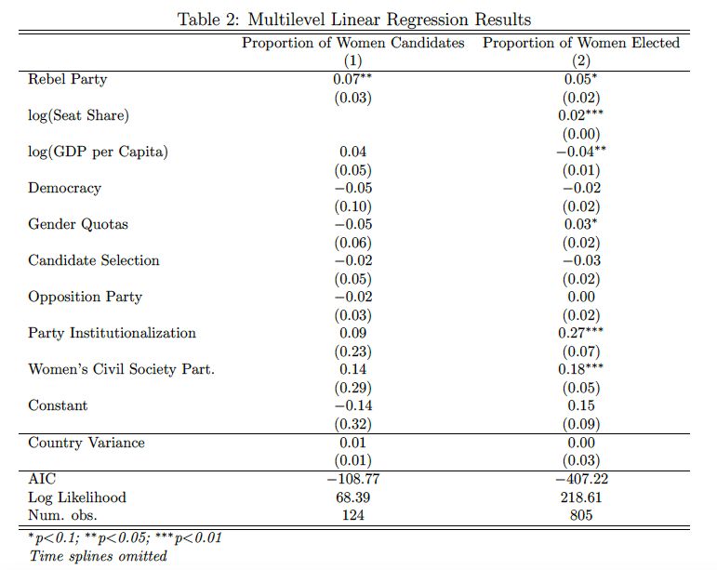
The Model:

Slide 6
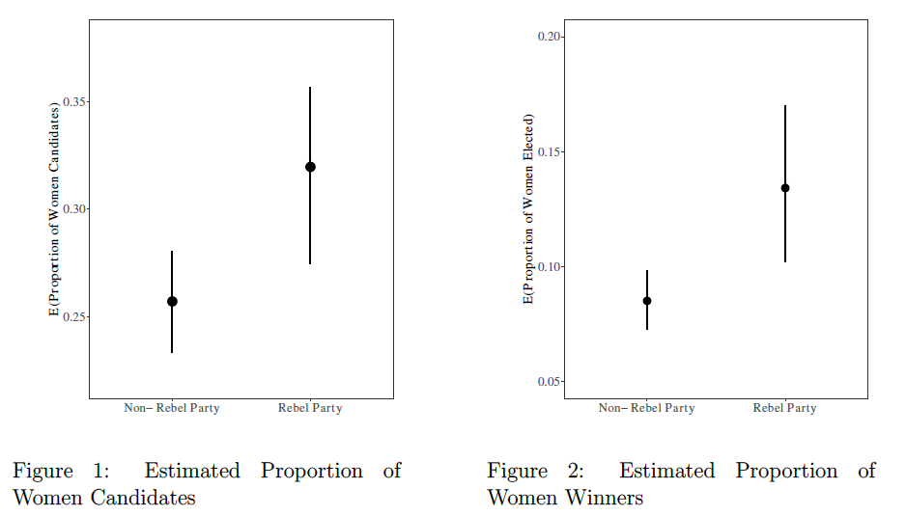
Findings:

Slide 7
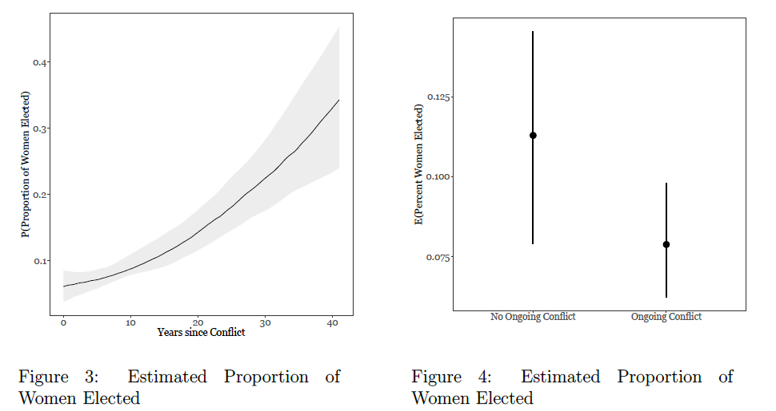
Findings:

Slide 8
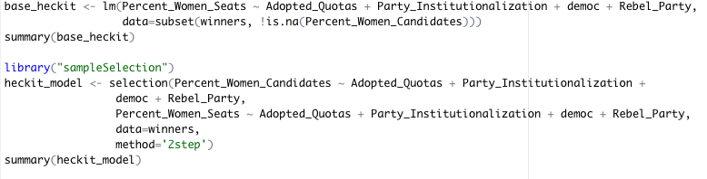
My Contribution: Multilevel Linear Regression vs. Heckit Regression
Need to account for the explanatory variable influencing the likelihood of a female candidate being put forward as well as the likelihood of a female candidate being elected

Slide 9
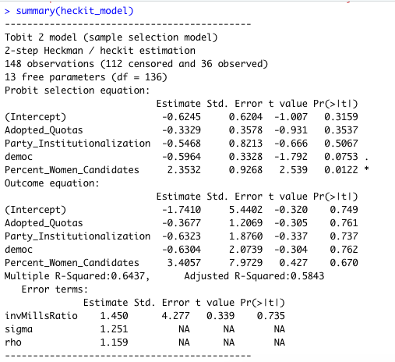
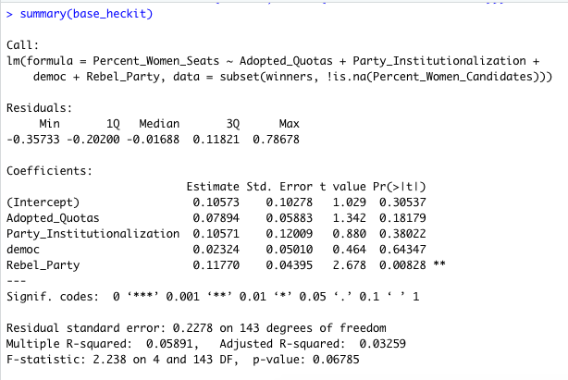
Comparison: Base Heckit vs. Full Heckit

Slide 10
Findings:
Heckit regression model was used to account for the explanatory variable influencing the likelihood of women candidates and women winners.
The results were significant, showing there is a large difference in r squared value (goodness of fit) between the base linear model and the Heckit model using the same outcome formula.
This shows us that these is variation in the outcome equation to explain.
The model captures the selection effect, showing how the variables influence the decision to put forward female candidates and impacts the decision to elect them.

